Slide 1


micro:bit entry video tutorial
Lesson 22
micro:bit creative lesson 22
“Music coin box”
YahBoom micro:bit creative tutorial

Slide 2
microbit entry video tutorial
Content
Part1
Part 2
Part3
Part 4
Part 5
Learning goals
Preparation
Handmade
Search for blocks
Combine blocks
YahBoom micro:bit creative tutorial

Slide 3
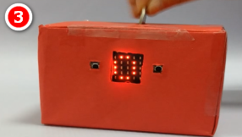
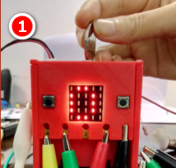
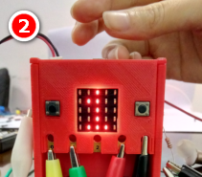
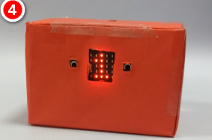
micro:bit entry video tutorial
Part 1
In this experiment, we used a homemade carton piggy bank as shown in figure 3,4. If you need the 3D printing piggy bank shown in figure 1,2. You can contact our customer service to get 3D printed drawings.
Learning
goals
After you download the program, you can put coin into this box, and Micro :bit dot matrix starts counting and display, while music is played.
YahBoom micro:bit creative tutorial

Slide 4
micro:bit entry video tutorial
Part 2
Hardware:
● 1 x Micro:bit Board
● 1 x headset
● 1 x Infrared receiver
● 1 x Infrared sender
● 1 x box
● 7 x Alligator clip
● n x packaging tape
● 1 x 27kΩresistor
● 1 x 100Ωresistor
Preparation
Then the micro:bit is connected to the computer through USB,
and the computer will pop up a U disk and click the URL in the
U disk to enter the programming interface.Input this URL
https://github.com/lzty634158/yahboom_mbit_en to get the package.
YahBoom micro:bit creative tutorial

Slide 5
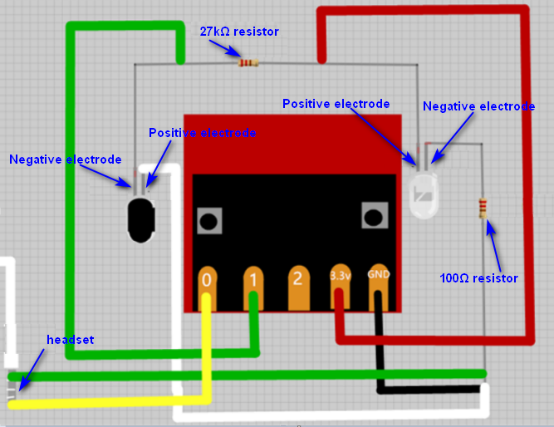
micro:bit entry video tutorial
Part 3
Connection
YahBoom micro:bit creative tutorial

Slide 6
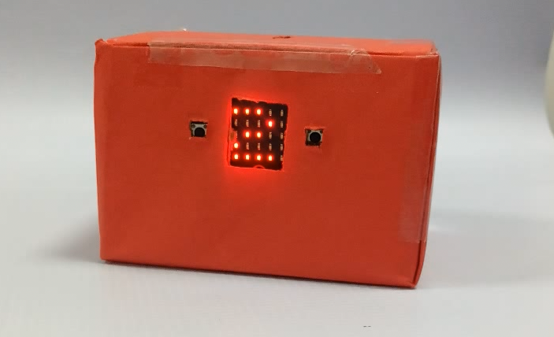
micro:bit entry video tutorial
Part 3
handmade
In this lesson, we need to use the infrared pair tube. The positive
and negative poles of the infrared pair tube.What is the difference?
The longer pin is the positive pole, and the short pin is the negative pole.
Children can connect the components with wire or alligator clips,
and then you fix the infrared pair tube by tape. Finally, you need to hide
all the lines inside the piggy bank.
YahBoom micro:bit creative tutorial

Slide 7
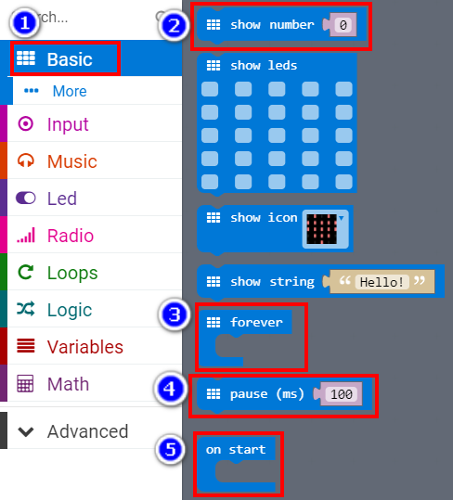
micro:bit entry video tutorial
Part 4
Search for
blocks
YahBoom micro:bit creative tutorial

Slide 8
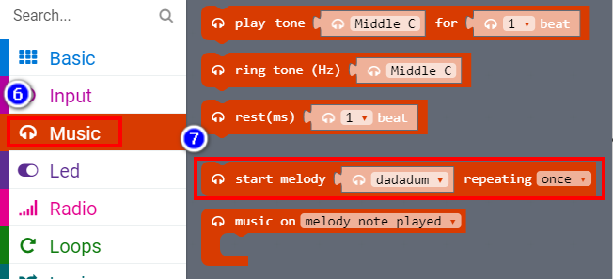
micro:bit entry video tutorial
Part 4
Search for
blocks
YahBoom micro:bit creative tutorial

Slide 9
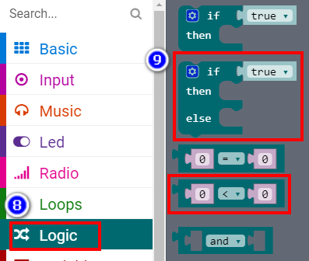
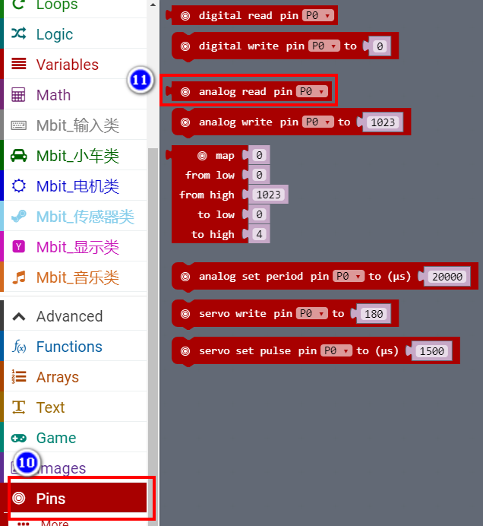
micro:bit entry video tutorial
Part 4
Search for
blocks
YahBoom micro:bit creative tutorial

Slide 10
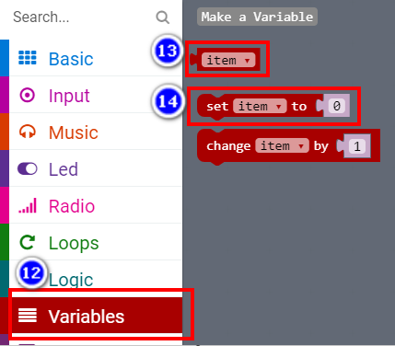
micro:bit entry video tutorial
Part 4
Search for
blocks
YahBoom micro:bit creative tutorial

Slide 11
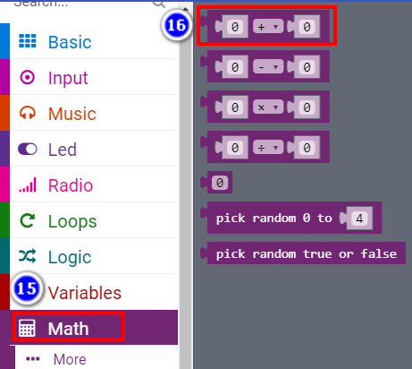
micro:bit entry video tutorial
Part 4
Search for
blocks
YahBoom micro:bit creative tutorial

Slide 12
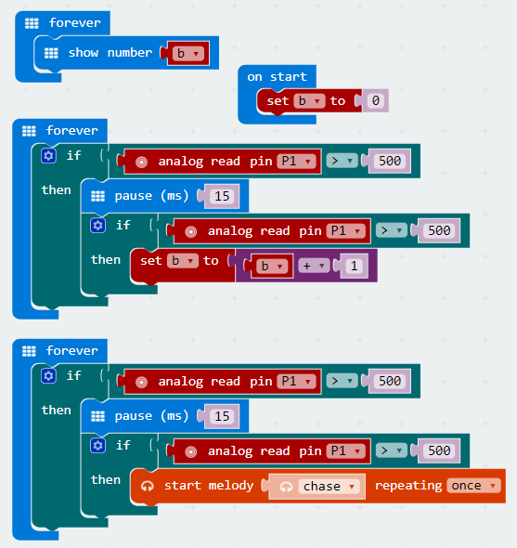
micro:bit entry video tutorial
Part 5
In this expriment, the coin needs to keep the same speed. The reason for not counting and always counting is the wiring error (or the wrong resistor is used). The case of counting multiple numbers is occur, you
need to modify delay time in code.
Combine
blocks
YahBoom micro:bit creative tutorial

Slide 13
micro:bit entry video tutorial
micro:bit
project
Thanks for watching!
Powered by
YahBoom
YahBoom micro:bit creative tutorial

